Slide 1
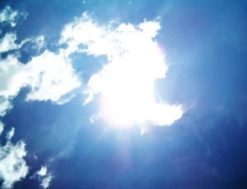
MODIS and CALIPSO observations near clouds
Várnai Tamás¹, Alexander Marshak², Robert Cahalan²,
Guoyong Wen¹, Weidong Yang¹, K. Frank Evans³
¹University of Maryland, Baltimore County
²NASA Goddard Space Flight Center
³University of Colorado

Slide 2
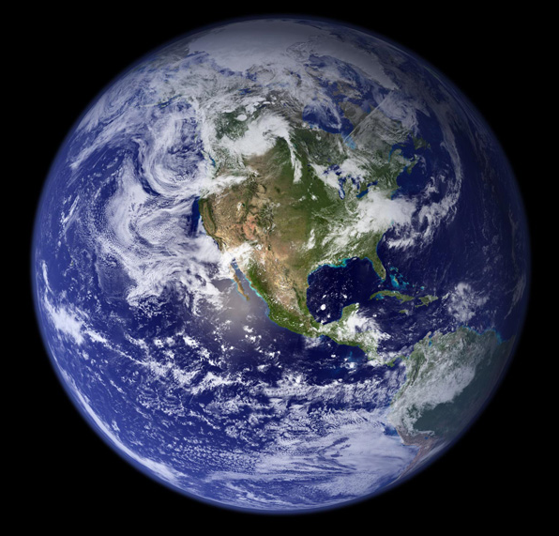
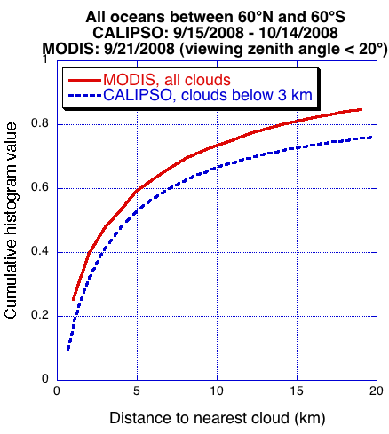
Clear areas near clouds
Motivation:
Help satellite studies of aerosol-cloud interactions
Aerosol remote sensing near clouds is challenging
Excluding areas near-cloud risks biases in aerosol data

Slide 3
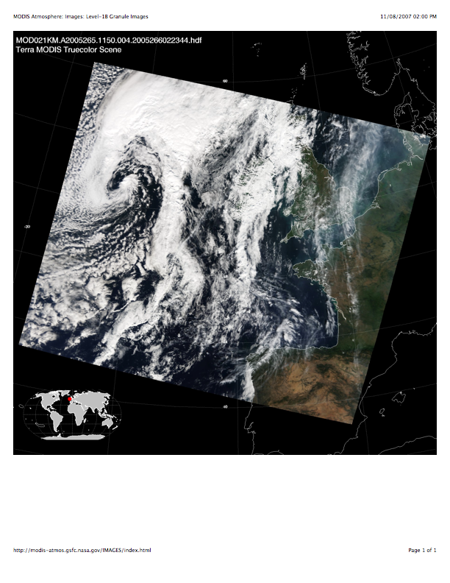
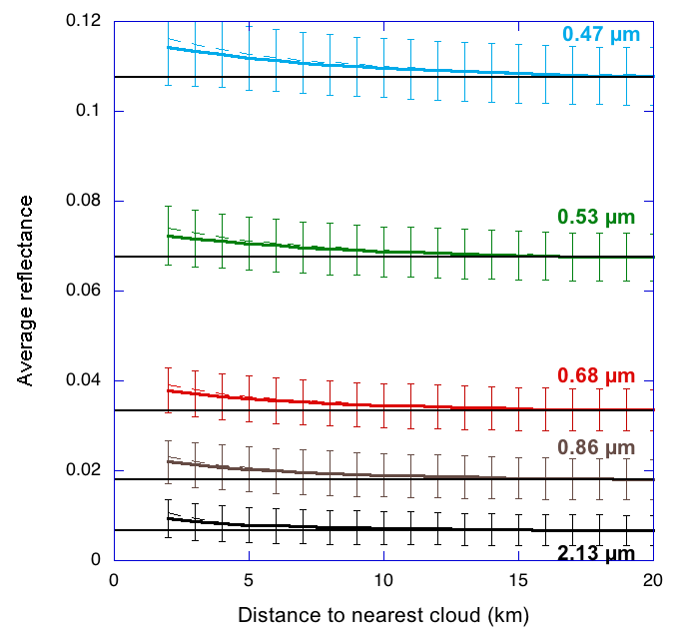
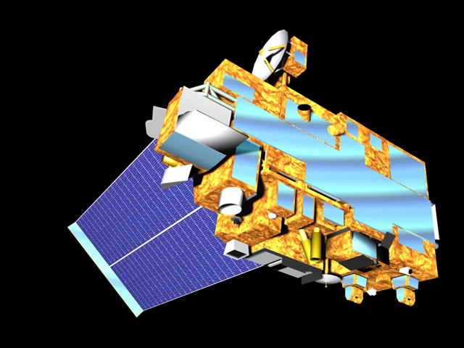
Enhanced solar reflectances
MODIS Terra
2000-2007, September 14-29

Slide 4
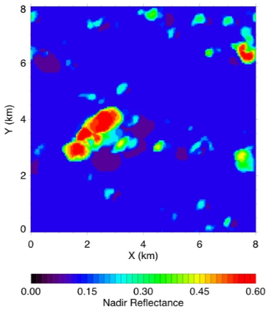
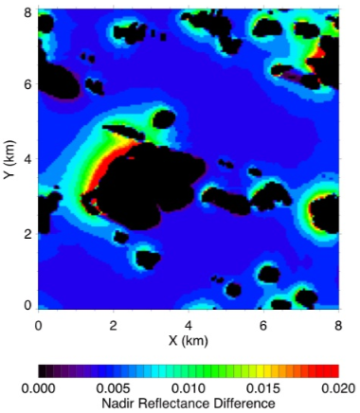
Asymmetry of reflectances
R_{3D} (0.47 µm)
R_{3D} (0.47 µm)
R_{3D}-R_{1D} (0.47 µm)
Orbit
Wen et al. (2007)
Frank Evans
Frank Evans
Wen et al. (2006)

Slide 5
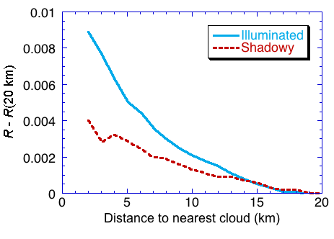
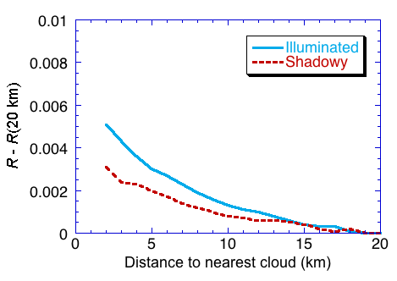
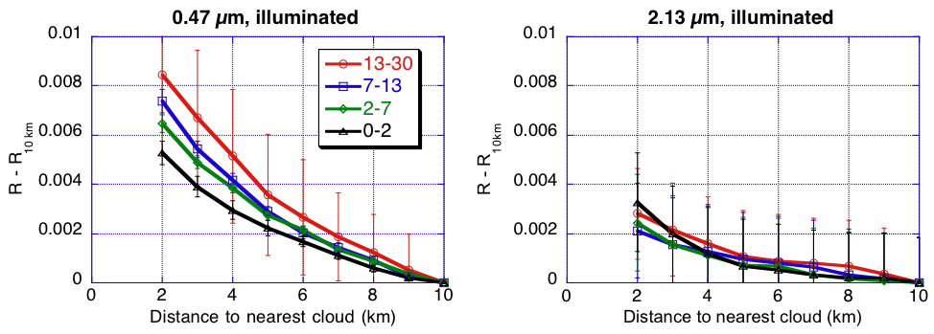
Asymmetry in MODIS data
0.47 µm 0.86 µm
Orbit
Várnai and Marshak (2009)

Slide 6
Contributions to enhancement
MODIS sensor
ARM clouds
molecular (76%)
+ aerosol (8%)
+ surface (16%)
Amazon clouds
molecular (82%)
+ aerosol (15%)
+ surface (3%)
aerosol or molecule
surface

Slide 7
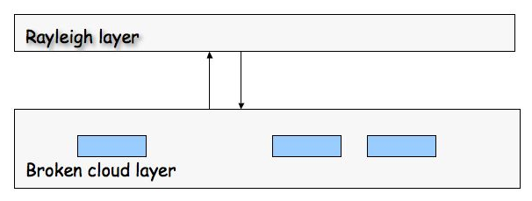
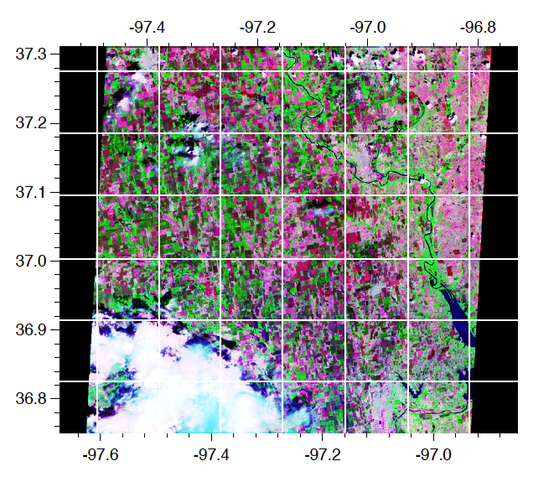
Simple correction method
Marshak et al. (2008)
ASTER image

Slide 8
3-D: MODIS vs. CALIPSO
MODIS: 3D enhancement
CALIPSO: no 3D enhancement

Slide 9
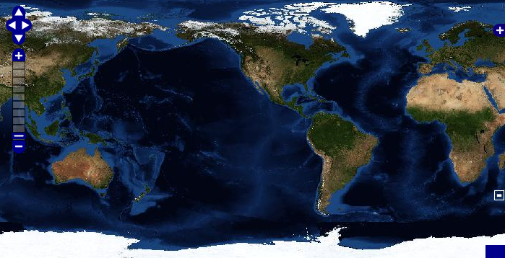
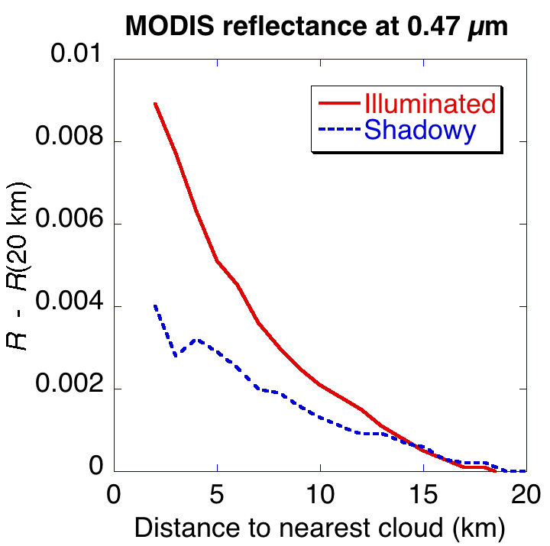
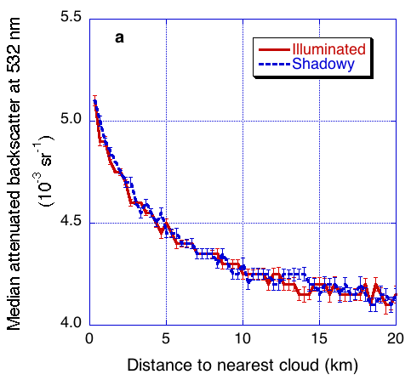
CALIPSO signal near clouds
Sept. 15-Oct. 14, 2008
30°-60°, Oceans
CALIPSO
MODIS
Várnai and Marshak (2010)

Slide 10
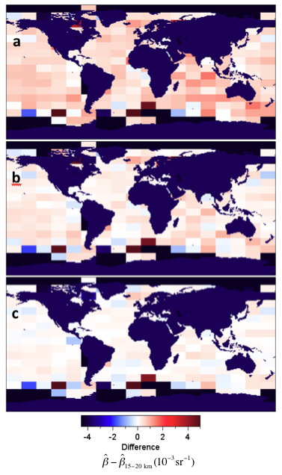
Map of CALIPSO enhancements
β_{0-5 km} – β_{15-20 km}
β_{5-10 km} – β_{15-20 km}
β_{10-15 km} – β_{15-20 km}
Várnai and Marshak (2010)
Difference (10⁻³ sr⁻¹)

Slide 11
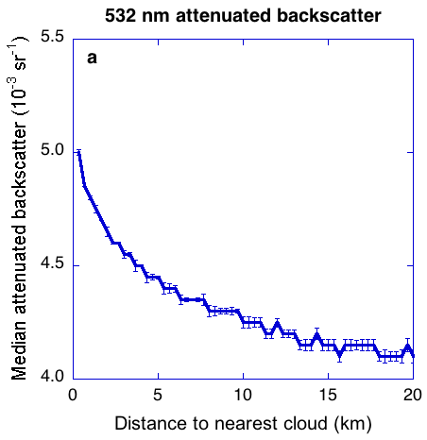
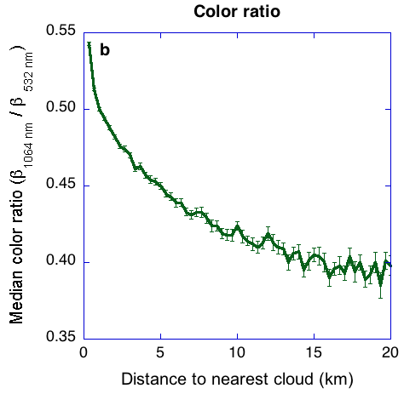
CALIPSO color ratios
Várnai and Marshak (2010)

Slide 12
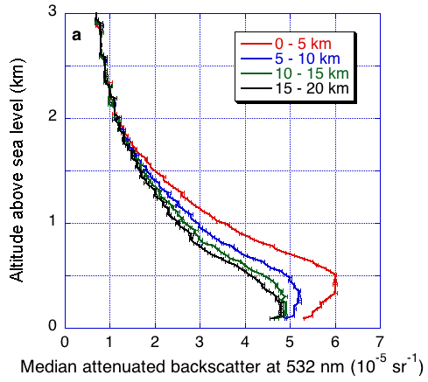
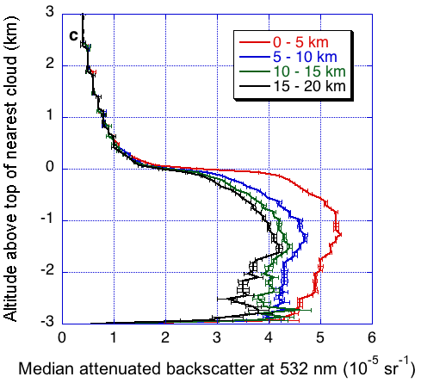
CALIPSO altitude dependence
Várnai and Marshak (2010)

Slide 13
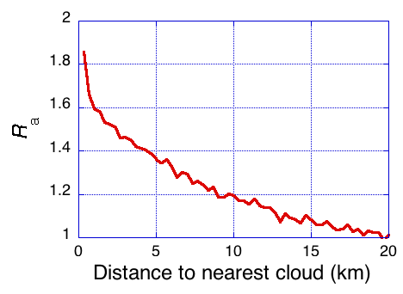
Aerosol backscatter

Slide 14
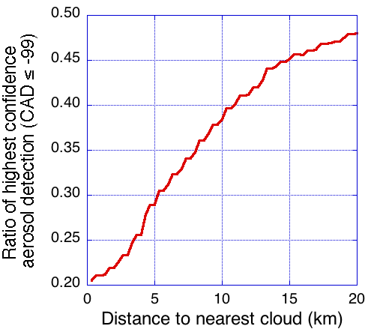
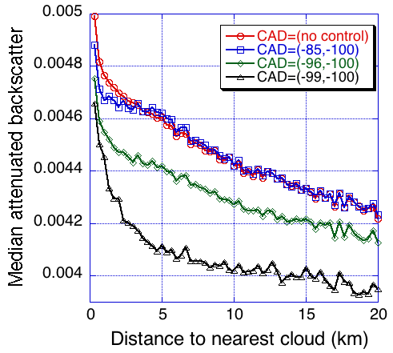
Aerosol detection confidence

Slide 15
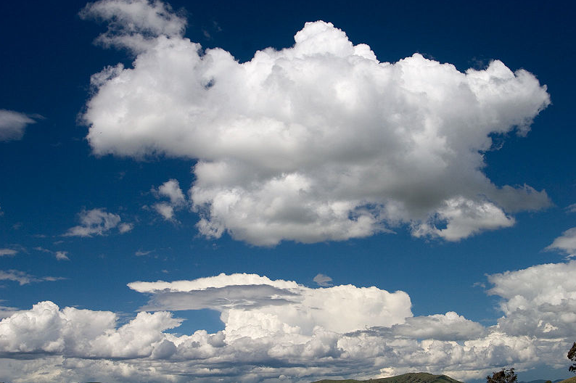
Summary
MODIS observations show that 3D radiative processes play an important role in creating clear sky reflectance enhancements near clouds;
Enhancements extend more than 10 km away from clouds and are stronger near illuminated cloud sides than shadowy ones;
Enhancements are stronger at shorter wavelengths and near optically thicker clouds which confirms the hypothesis of “apparent bluing of aerosols”.
CALIPSO observations show that clouds are surrounded by a transition zone of enhanced particle backscatter and size over most oceanic regions, especially near cloud top altitude.
Transition zone needs to be considered in studies of aerosols and aerosol-cloud interactions, but solar reflectance measurements in transition zone need to be corrected for 3D effects; a simple two-layer model shows promise for such corrections.

